Slide 1
CLM Spectrometer Calibration/Performance Tasks Introduction
ACE YS Sustaining Source: TINR

Slide 2



YS(1)375 Source
LPPS
Spectrometer
Mixing fiber
Y
H
Z
Cal. source
Shutter box
V
F1
F2
F3
F4
OPTICAL BASE FRAME
L1
L6
L5
≅ 4%
L4
M2
BS2
L2
L3
ND1
5x ND
1x slot
3x spare
M1
≅4%
M3
BS1
LWP
SWP
ND wheel
MOTOR FRAME

Slide 3
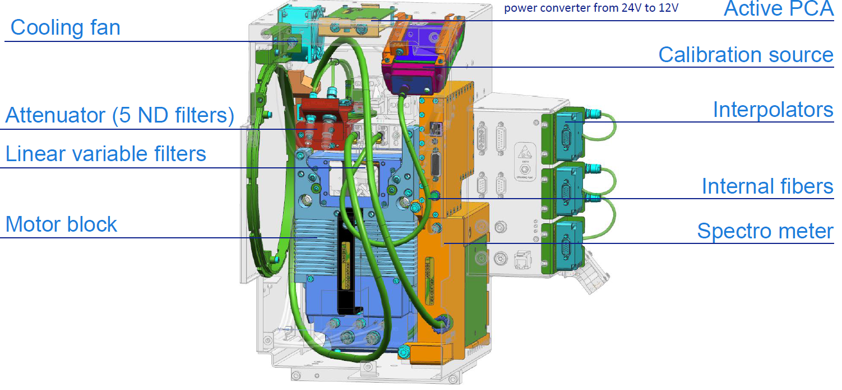

Slide 4
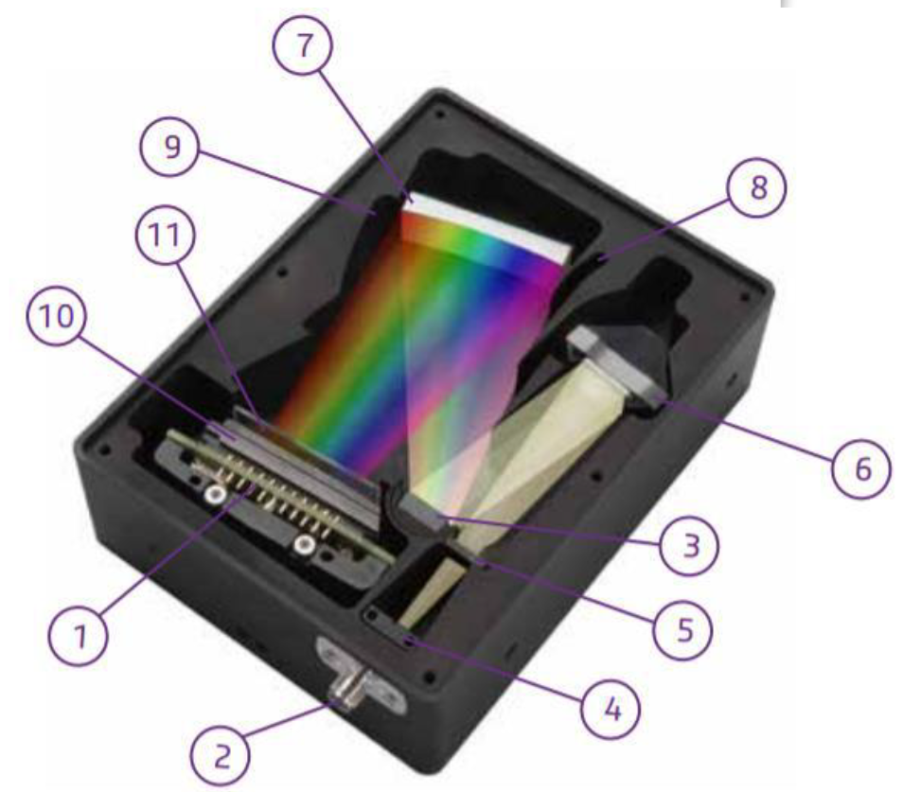
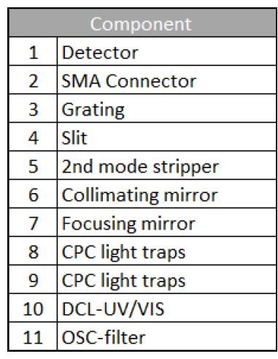
Spectrometer structure
Supplier: Avantes
Notes:
Calibration should be conducted at least once a year, regardless of how often the spectrometer is used. Results can be affected by long-term lack of use as well as things like dust being knocked about can adversely affect results.
https://verichek.net/calibrating-spectrometer.html
As for the frequency to do spectrometer calibration to ensure its precision, I would suggest CSE to tell customer that it is suggested to perform SM cal. on daily basis to ensure the precision or at least to do annual cal.
Essential Equipment Care: Annual Spectrophotometer Calibration

Slide 5
CLM tasks overview
Internal Spectrometer
CL Module
Task 623
DC Offset
Task 604
DC offset
Task 600
WL coarse
Task 605
WL home offset
Task 611
Non-linearity
Task 612
Irradiance
Task 602
Enc Pos to WL
Task 625
Enc Pos to WL
Task 626
WL fine
Task 619
WL fine
Task 601
ND filter
Task 641
ND filter
Task 628
Spectrometer
Task 603
WL offset
Task 630 has 603 included
Task 630
CLM spectral
existing calibration
< SP18
new calibration
performance task

Slide 6
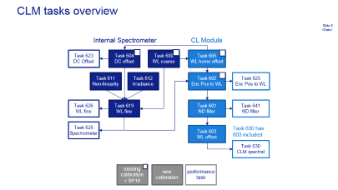
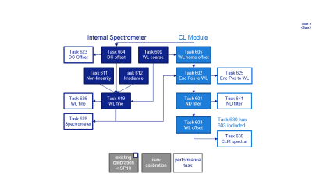
#600 Illumination Spectrometer Wavelength Calibration

Slide 7
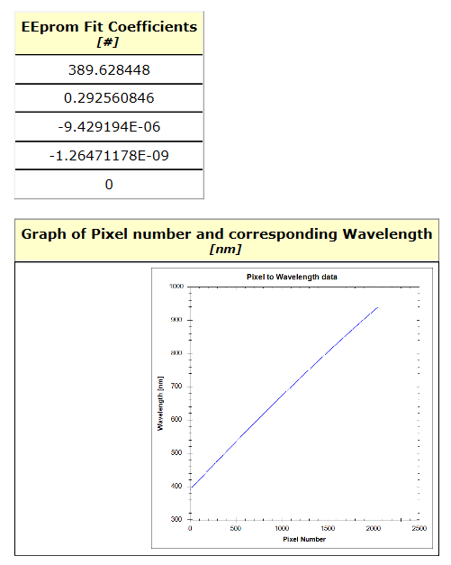
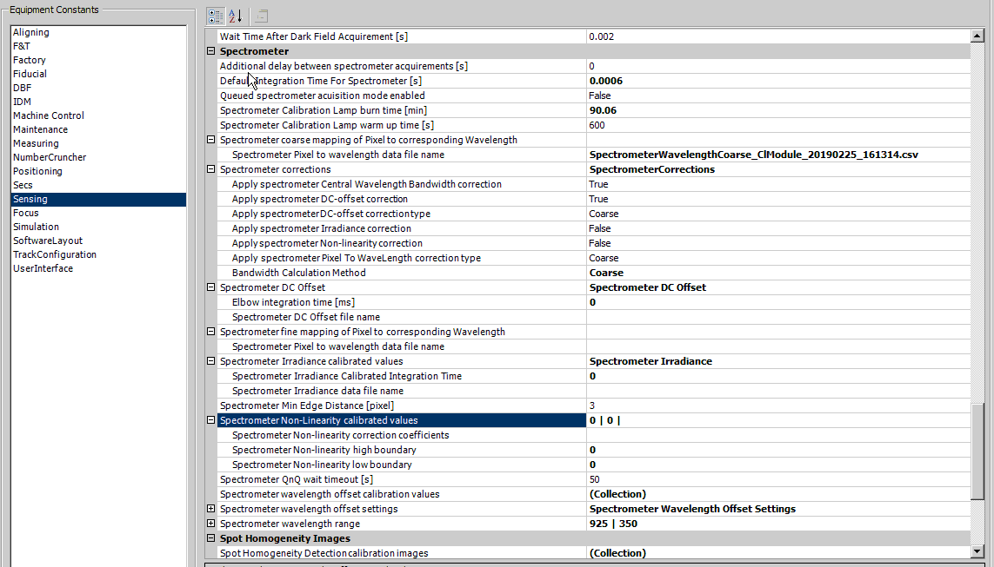
#600 Illumination Spectrometer Wavelength Calibration
Goal:
Reads supplier calibration from the EEPROM in the spectrometer and stores it in ECs (takes only a few seconds)
Reasons for introduction:
To improve the accuracy of the spectrometer measurements.
Task dependency: None.

Slide 8
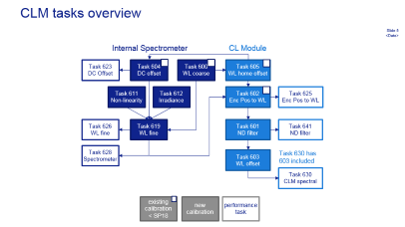

#604 IlluminationSpectrometerDCOffsetCalibration
#623 IlluminationSpectrometerDCOffsetPerformance
Notes:
Insert→Links→Zoom→Insert Section

Slide 9
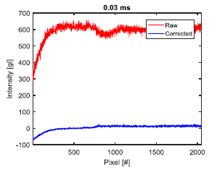
#604 – Calibrate Illumination Spectrometer DC Offset
Goal Task: To calibrate the spectrometer by diminishing the effects of unwanted noises, so that it is ready for more accurate further measurements. DC offset: Dark measurement extracted from actual measurement
Reason for introduction: To improve the accuracy of the spectrometer measurements.
Task Dependencies: 605
Notes:
- DC offset can be caused by DC voltage, AC voltage, vibrations and temp changes. It is not a part of actual measurement so it should be excluded.
- We take the spectrometer readings with absolute no light. And later on extract these readings from actual light measurements. So we eliminate the noise.

Slide 10
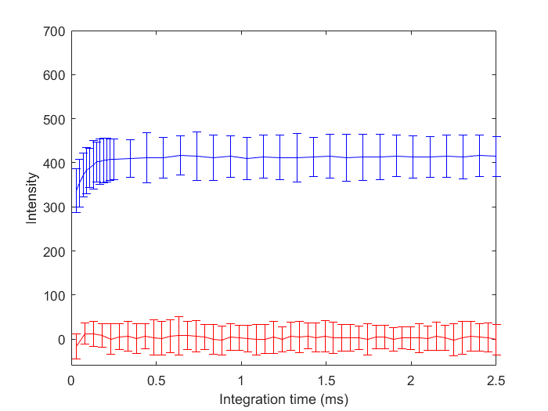
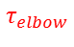
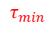
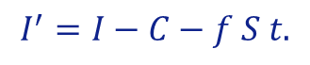
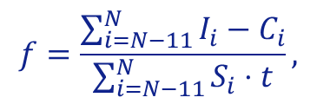
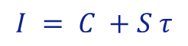
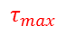
Spectrometer DC Offset Calibration In Task #604
Apply linear regression to obtain the coefficients, C and S, of the fitting line.
Blue→uncorrected
Red→corrected
$$I = C +S τ$$
Calculate the slope scaling factor(using the last 12 dark pixels)
2.7
$$f=\frac{\sum_{i=N−11}^{N}{I_{i}−C_{i}}}{\sum_{i=N−11}^{N}{S_{i}⋅t}},$$
Subtract the fitted spectra from the measured spectra to get the corrected spectra I’
$$τ_{min}$$
$$τ_{elbow}$$
$$τ_{max}$$
$$I^{′}=I−C−f S t.$$

Slide 11
How to perform task #604
1. Equipment constant → Sensing → Spectrometer
Make “True”
Choose “Fine”
Apply spectrometer DC-offset correction type:
Coarse: Calibration method is from the supplier (EEPROM)
Calculating average grey level of 2035~2047 pixels (shielded pixels) and served as EC.
Subtract every pixel’s signal with the EC for DC-offset calibration.
Fine: Calibration method is from ASML → Task #604

Slide 12
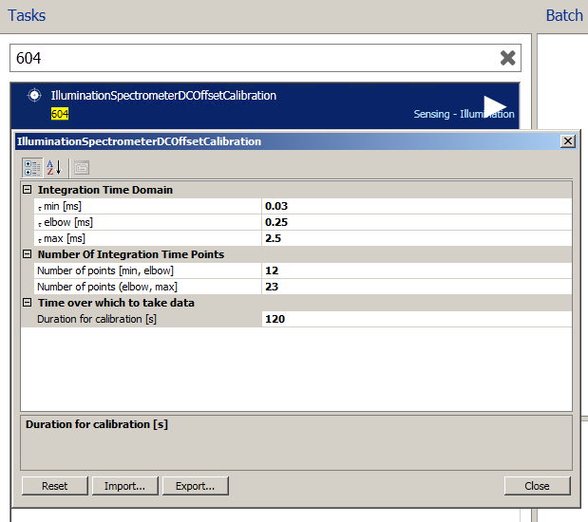
How to perform task #604
2. Select task #604, check the default input setting and commit ECs if there is no problem
Default input setting:
Notes:
The temperature fluctuation is of time scale of 120s.

Slide 13
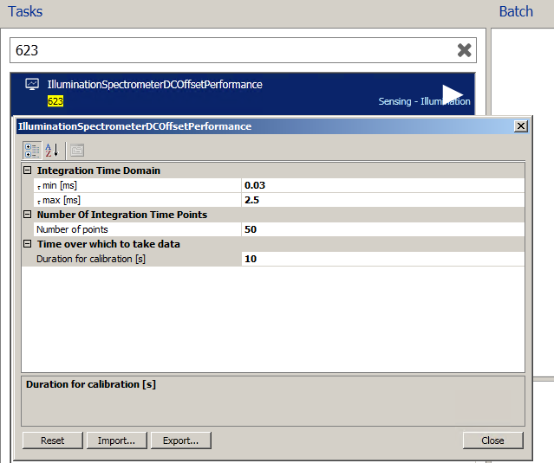
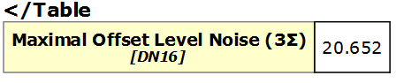
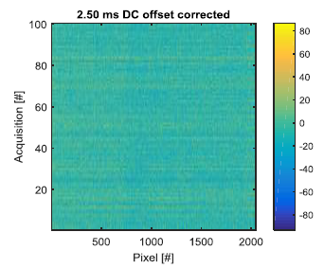
How to verify task #604
1. Select task #623, check input setting, run the task.
2. Check the following specification:
Uniformity of pixels across each acquisition at given integration time
< 50.
pixels

Slide 14
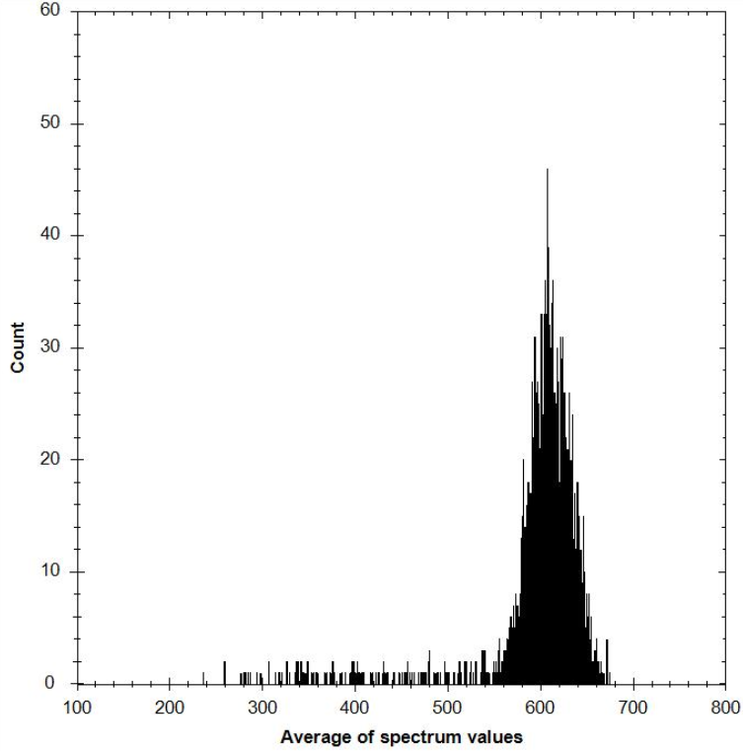
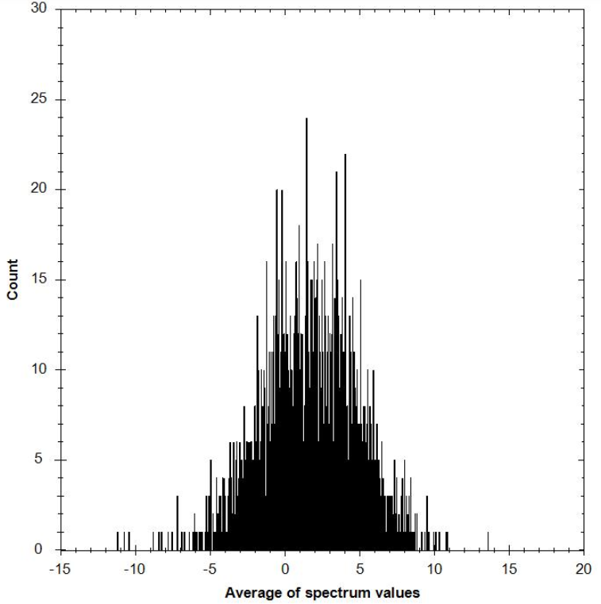
Spectrometer DC Offset Calibration Validation
2.5 ms int. time | Before cal. | After cal.
Reports
Average Spectrum Histogram
 |  | Maximal integration time
Average DCOffset [DN16] | Min | 236.019
 | Mean | 597.893
 | Max | 678.794
Spatial Noise [DN16] |  | 169.838
 |  | Maximal integration time
Average DCOffset [DN16] | Min | -11.227
 | Mean | 1.603
 | Max | 13.624
Spatial Noise [DN16] |  | 9.598
~169
~9
Notes:
Spatial noise is the 3 sigma of all pixels in a specific integration time.

Slide 15
OCAP
SPEC: Maximal offset level noise (3∑) < 50
No OCAP for current version
Potential Problems | Possible Causes | Solutions
Pixel noise too high Frame-to-frame noise too high | Increased temperature Presence of stray light Spectrometer HW issue | Check CL module spectrometer temperature, ensure temp as close to 35̊C. Ensure spectrometer shielded properly from stray light during calibration. Check noise histogram to see if an increase in hot-pixels due to aging might have occurred. In such a case, the spectrometer might be defective.

Slide 16
#611 Spectrometer Non-linearity Calibration

Slide 17
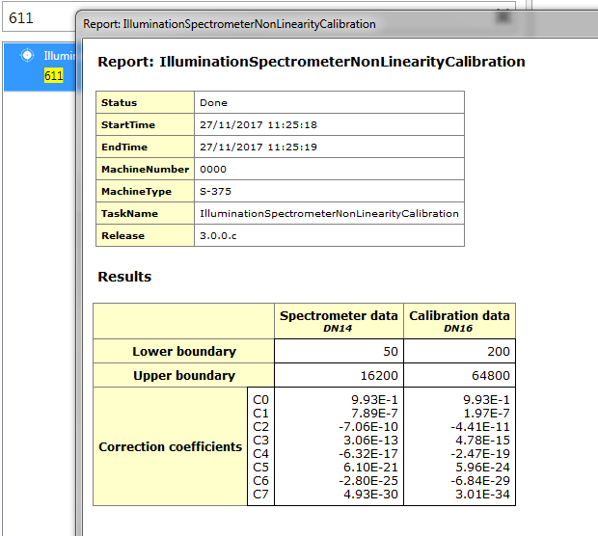
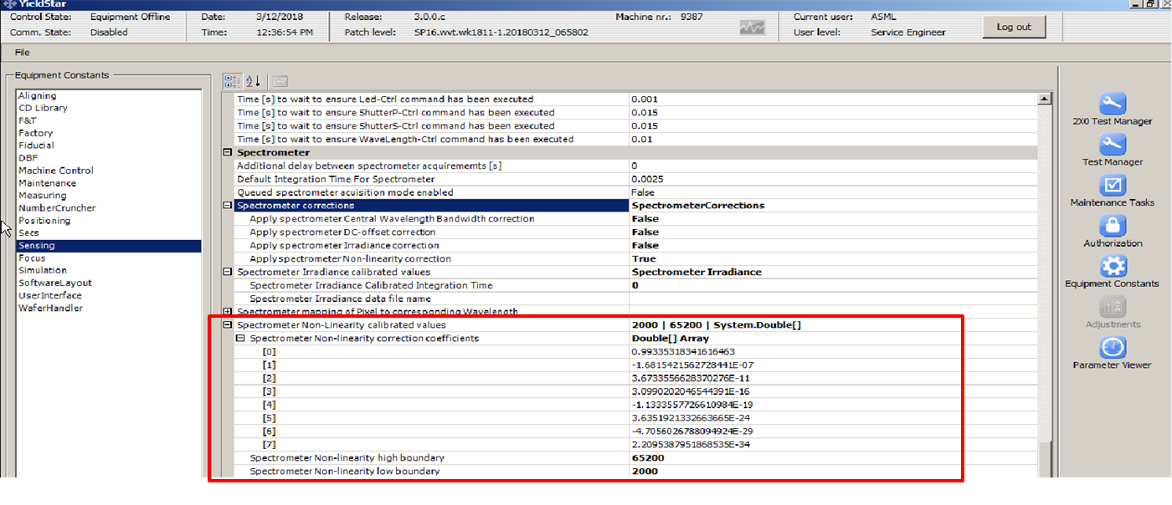
#611 – Calibrate Illumination Spectrometer Non-Linearity
Goal Task: To get the calibration values of the spectrometer for non-linearity from the EEPROM of the spectrometer
Reason for introduction: To improve the accuracy of the spectrometer measurements.
Task Dependencies: None
Tip: If there are no values on this table, then the spectrometer was not calibrated.
Notes:
Non linearity: Calibrated before, written in EEPROM of the spectrometer. This calibration does only collect that data.
One tip
Non-linearity here is defined as the difference between pixels of spectrometer.

Slide 18
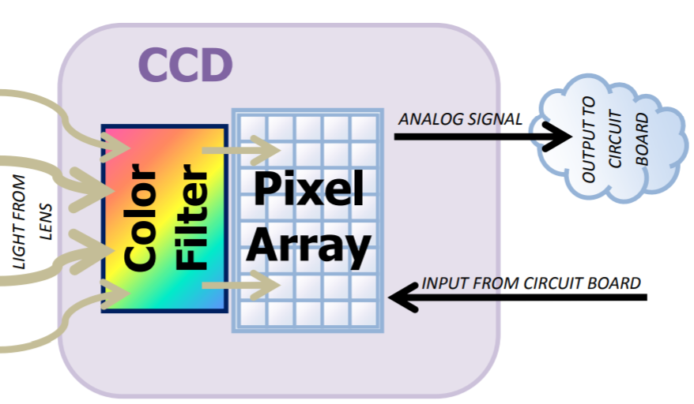
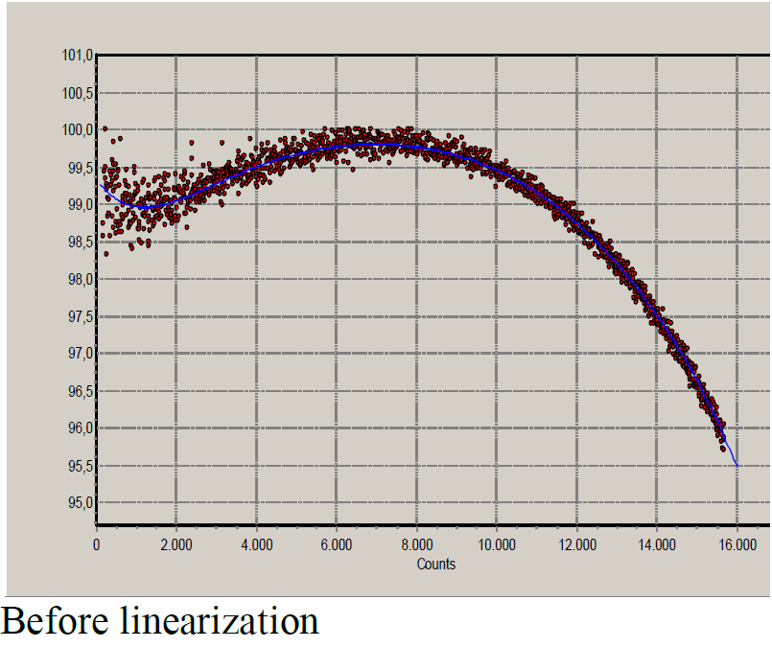
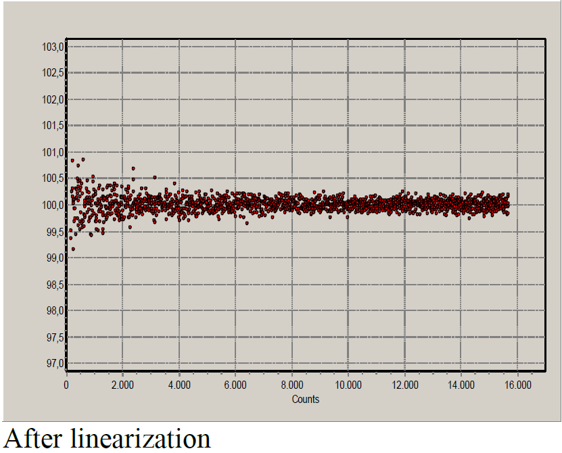
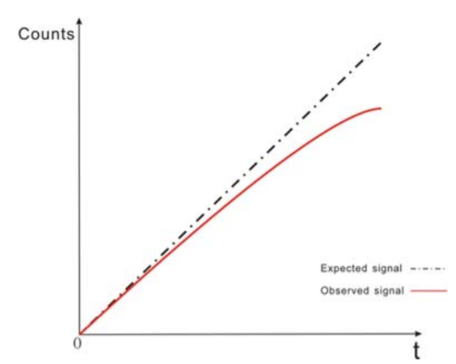
Spectrometer Linearity
How linear between the number of electrons generated and the voltage produced of the pixels in the detector.
Electron-to-voltage nonlinearity results in slight, but detectable errors in the calculation of normalized values (absorbance, transmission or irradiance).
7th order polynomial regression fit is stored in EEPROM.
Normalized count/sec
Normalized count/sec
Fig. Parts of a Charged-Coupled Device
Fig. Response of a pixel
This is done by the Avantes!
Calibration data stores in EEPROM!
Notes:
The polynomial is calculated by measuring the AD Counts for a number of pixels (10) over different integration times to get the pixel data over a wide range from (in this example) 200 to 15500 counts. The measured AD Counts are corrected for the offset value by subtracting the dark spectrum. For each of the 10 pixels in the measurement the counts per second is calculated and normalized to its maximum value, which is set to 100%. In the left figure below the normalized counts per second are displayed against the measured AD Counts (corrected for dark). The polynomial is the best fit through these measured points. The right figure below has been created by applying the polynomial to the measured points, and recalculating the normalized counts per second. It is important to realize that the polynomial should be applied to the AD Counts that have been corrected for the dark counts.

Slide 19
Spectrum Non-linearity Correction In Task #611
Measure an uncorrected spectrum S with a corresponding integration time t_{int}.
Read calibrated ECs (polynomial coefficients) and calculate correction Q for each pixel.
Apply correction Q to the uncorrected spectrum S.
Q_{i} = C₀ + C₁ T_{i} + C₂ T_{i}² + + C₃ T_{i}³ + + C₄ T_{i}⁴ + C₅ T_{i}⁵ + + C₆ T_{i}⁶ + + C₇ T_{i}⁷
C₀…C₇: Coefficients in the EC SpectrometerNLArray.
S_{i}’ = S_{i} / Q_{i}
S_{i}: Uncorrected spectrum.
Notes:
For each value (i.e. each pixel) i, calculate T by inspecting the intensity S_{i} of pixel I of the spectrum via the following scheme:
If S_{i} is smaller than the EC SpectrometerNLLow, then T­_{i} = SpectrometerNLLow.
Else if S­_{i} is greater than the EC SpectrometerNLHigh, then T_{i} = SpectrometerNLHigh.
Else T_{i} = S_{i}.
In other words, the spectrum T is the result of clamping the spectrum S to the range [SpectrometerNLLow, SpectrometerNLHigh].

Slide 20
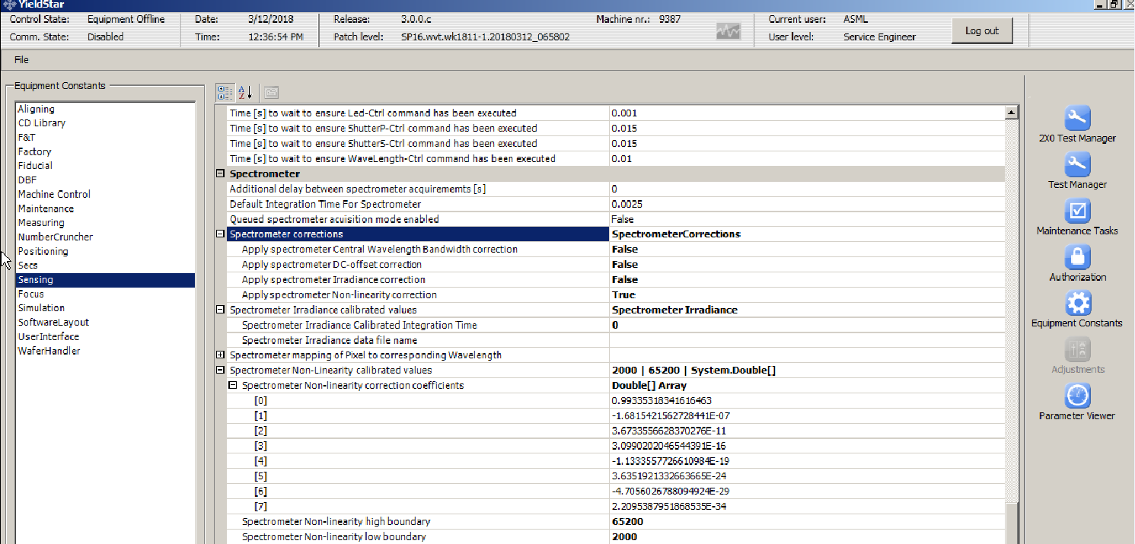
Spectrum Non-linearity Correction In Task #611
The spectrometer installed in the CL module of YS375/1375 systems has been calibrated for non-linearity by the supplier.
Task #611 accesses the calibrated ECs and corrects the spectrum based on YS integration time.

Slide 21
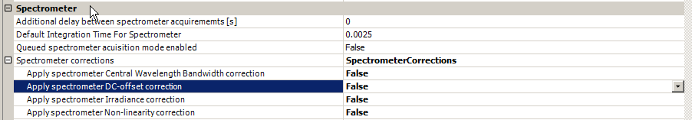
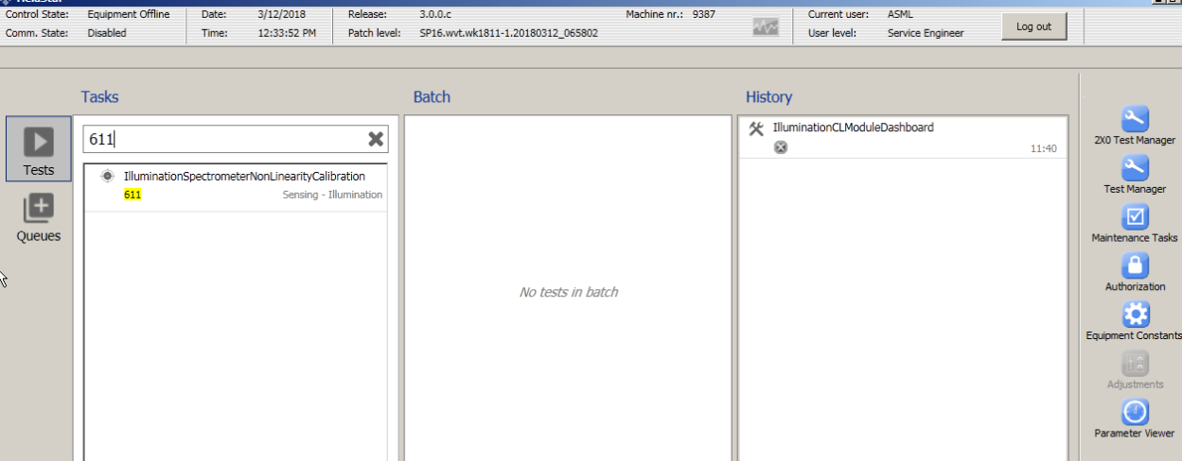
How To Perform Task #611
Equipment constant → Sensing → Spectrometer
Make true
Run task #611 and commit ECs.
No manual input

Slide 22
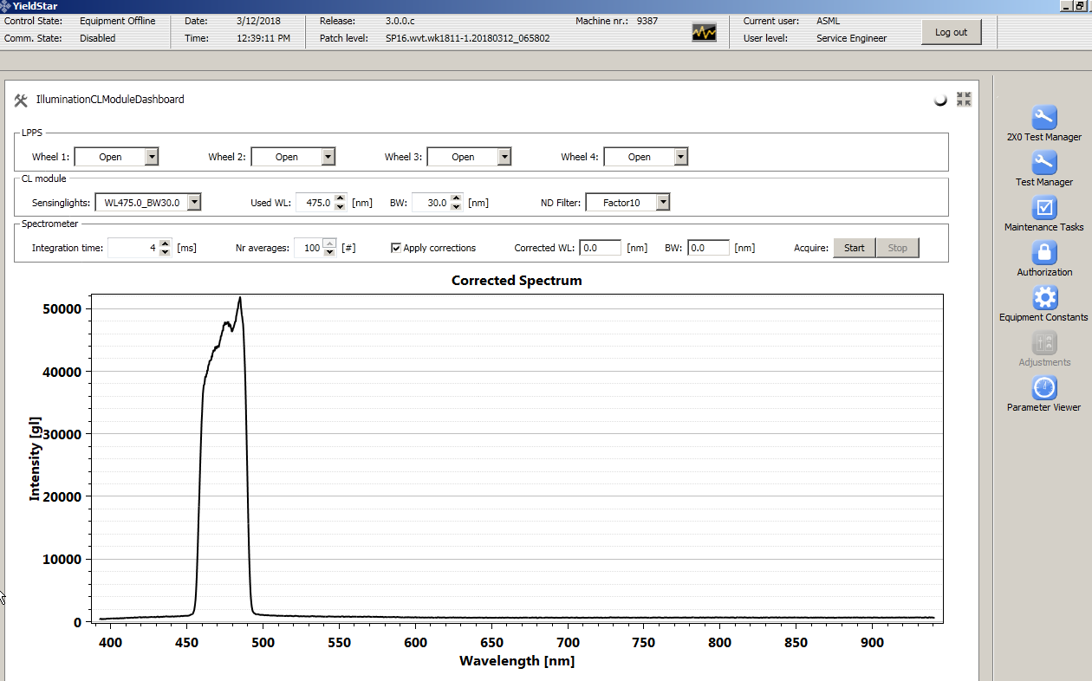
How To Verify Task #611
Run task #609 with selected CW/BW.
Check “Apply corrections”.
The non-linearity correction should now take effect !

Slide 23
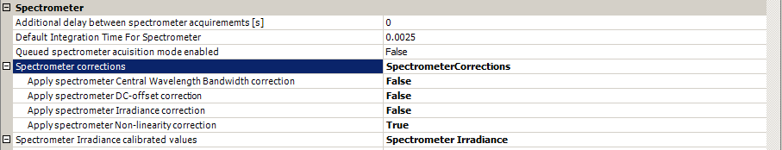
Non-linearity Calibration Validation
Fig. Spectrums comparisons: Apply Spectrometer non-linearity Correction True vs False

Slide 24
#612 Spectrometer Irradiance Calibration

Slide 25
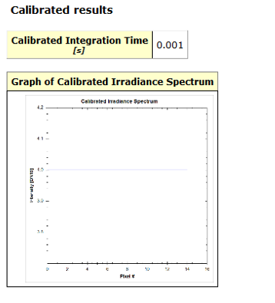
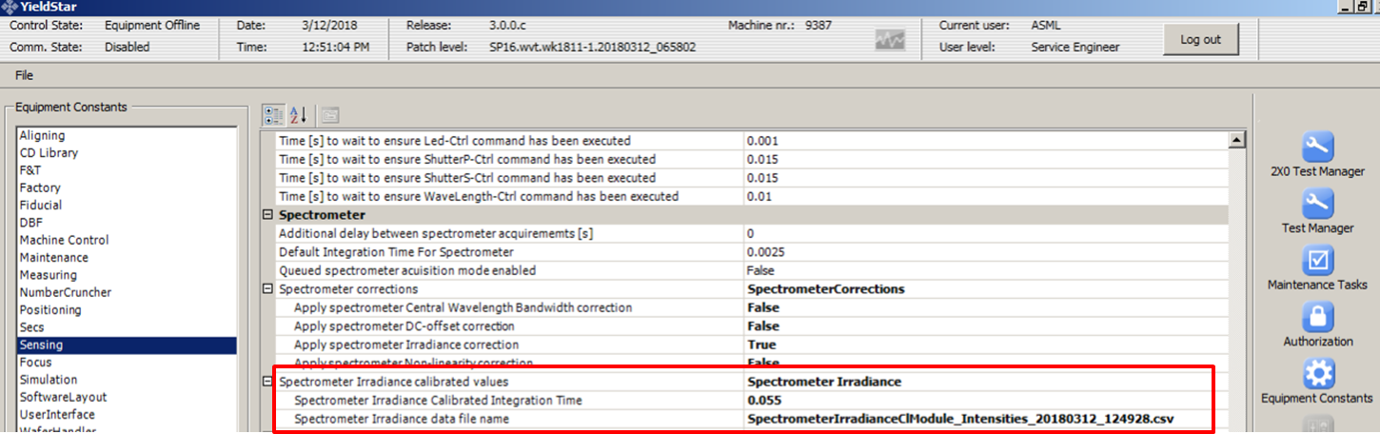
#612 – Calibrate Illumination Spectrometer Irradiations
Goal Task: To get the calibration values of the spectrometer for irradiance from the EEPROM of the spectrometer
Reason for introduction: To improve the accuracy of the spectrometer measurements.
Task Dependencies: None
Notes:
Irradiance: Calibrated before, written in EEPROM of the spectrometer. This calibration does only collect that data.
One tip
Irradiance here is defined the amount of light certain pixels accept.

Slide 26
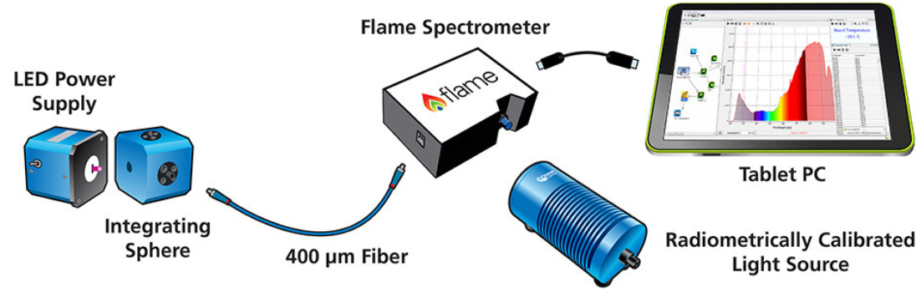
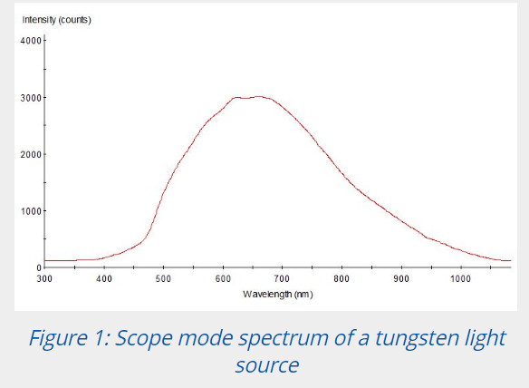
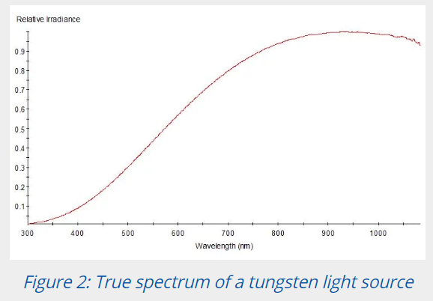
(Relative) Irradiance Calibration Principle
Fake LPPS
cal. source
Fig. Irradiance calibration setup
The raw number of counts for each pixel in the array without any processing or correction for spectrometer sensitivity.
Each spectrometer has a different response function that comes from a combination of its individual elements(electrical & optical response of each pixel) and alignment.
This is done by Avantes!
Calibration data stores in EEPROM!

Slide 27
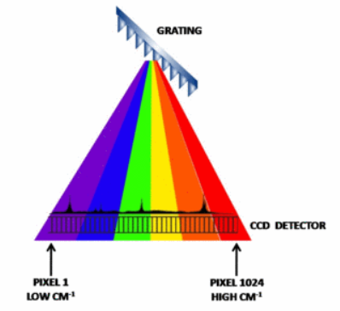
Spectrum Irradiance Correction In Task #612
grating
Measure an uncorrected spectrum S with a corresponding integration time t_{int}.
Read calibrated ECs and perform below calculation for each pixel.
LPPS
S_{i}’ = (t_{cal} / t_{int}) x (S_{i} / I_{i})
1D CCD detector
In Avantes spectrometer
Pixel 1
Pixel 2048
t_{cal}: EC SpectrometerIrIntTime.
I: EC SpectrometerIrArray.

Slide 28
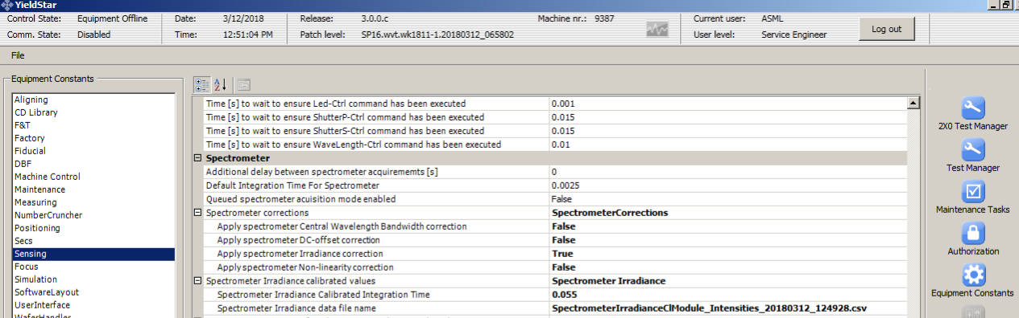
Spectrum Irradiance Correction In Task #612
The spectrometer installed in the CL module of YS375/1375 systems has been calibrated for irradiance by the Avantus.
Task #612 accesses the calibrated ECs and corrects the spectrum based on YS integration time and temperature.

Slide 29
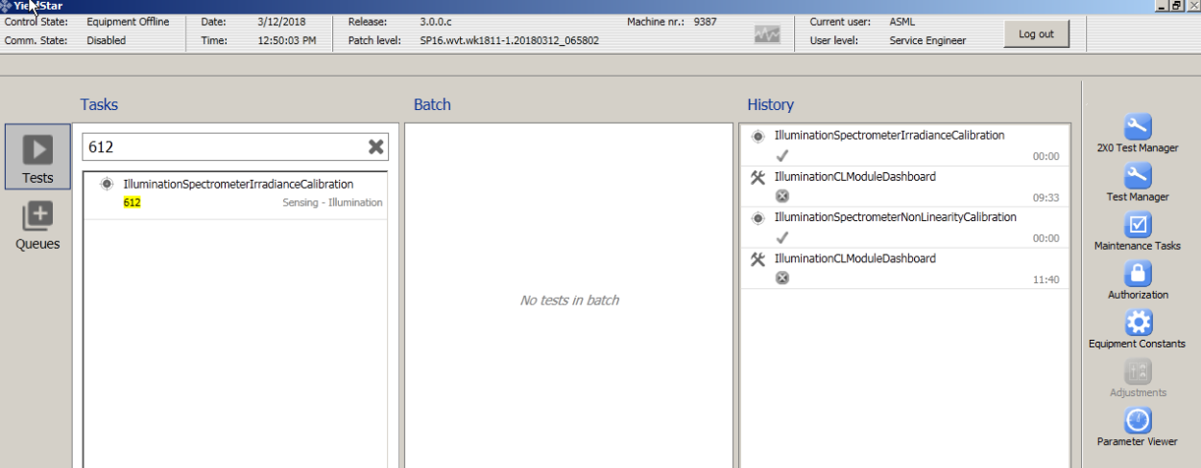
How To Perform Task #612
Equipment constant → Sensing → Spectrometer
Make true
Run task #612 and commit ECs.
No manual input

Slide 30
How To Verify Task #612
Run task #609 with selected CW/BW.
Check “Apply corrections”.
The irradiance correction should now take effect !

Slide 31
Irradiance Calibration Validation
Fig. Spectrums comparisons: Apply Spectrometer Irradiance Correction True vs False

Slide 32
#619 Calibrate Illumination Spectrometer Wavelength Fine
#626 Check Illumination Spectrometer Wavelength Fine

Slide 33
#619 – Calibrate Illumination Spectrometer Wavelength Fine
Goal Task: To calibrate the internal spectrometer such that it gives more accurate wavelength measurements. The atomic lines are representing a certain WL and with this task a conversion to Pixel value is created. That is why we call this task “PixeltoWavelength Calibration”
Reason for introduction: To improve the accuracy of wavelength measurement done by internal spectrometer
Task Dependencies: 600, 604, 611, 612
Reasons to repeat the calibration:
EC of task 600 is calibrated at room temperature while main operation temperature for CLM is 35°C.
ASML requires higher accuracy that the supplier provides.
Task 600 uses the supplier calibration as a coarse calibration, task 619 uses calibration lamp installed in CLM to perform the calibration.
Over the 7 years of machine life time, to be able to recalibrate the spectrometer to compensate for drifts (e.g. due to changes in temperature) w/o sending SM back to the supplier.
Notes:
It makes the spectrometer wavelength measurement much more efficient, accurate.

Slide 34
Internal Spectrometer
CL Module
Task 623
DC Offset
3
1
2
Task 604
DC offset
Task 600
WL coarse
Task 605
WL home offset
Task 611
Non-linearity
Task 612
Irradiance
Task 602
Enc Pos to WL
Task 625
Enc Pos to WL
5
4
Task 626
WL fine
Task 619
WL fine
Task 601
ND filter
Task 641
ND filter
Task 628
Spectrometer
Task 603
WL offset
Task 630 has 603 included
Task 630
CLM spectral

Slide 35
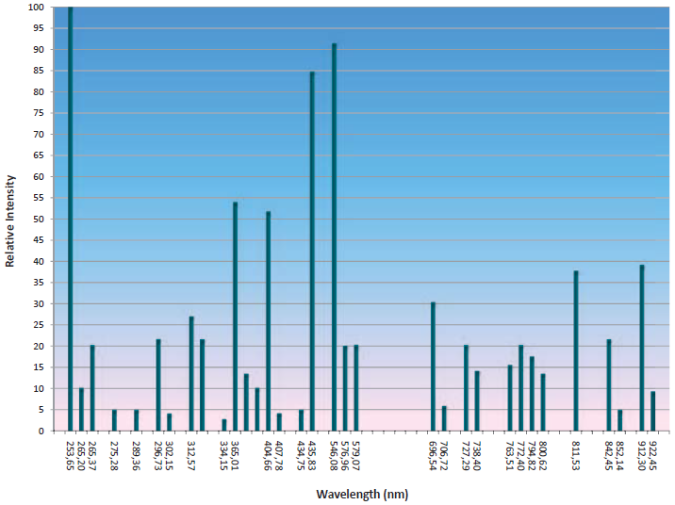
Calibration light source
Wavelength | Regime | Atom
253.652 | 0 | Hg
296.728 | 0 | Hg
302.150 | 0 | Hg
313.155 | 0 | Hg
334.148 | 0 | Hg
365.015 | 0 | Hg
404.656 | 2 | Hg
407.783 | 0 | Hg
435.833 | 3 | Hg
546.074 | 3 | Hg
576.960 | 2 | Hg
579.066 | 2 | Hg
696.543 | 2 | Ar
706.722 | 1 | Ar
714.704 | 0 | Ar
727.294 | 1 | Ar
738.398 | 1 | Ar
750.387 | 0 | Ar
763.511 | 2 | Ar
772.376 | 0 | Ar
794.818 | 1 | Ar
800.616 | 0 | Ar
811.531 | 0 | Ar
826.452 | 2 | Ar
842.465 | 0 | Ar
852.144 | 1 | Ar
866.794 | 0 | Ar
912.297 | 2 | Ar
922.450 | 1 | Ar
Warm-up time: 5 min
Lamp lifetime: 1500 hrs
Ar/Hg light
3 intensity regimes:
0: Not used.
1: Low intensity.
2: Medium intensity.
3: High intensity.

Slide 36
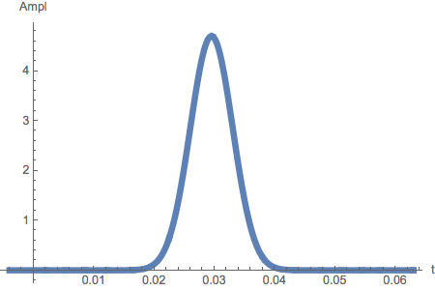
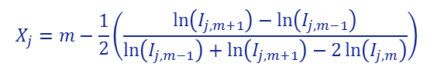
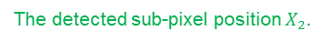
Sub-pixel peak detection algorithm
$$X_{j}=m−\frac{1}{2}\left(\frac{\ln\left(I_{j,m+1}\right)−\ln\left(I_{j,m−1}\right)}{\ln\left(I_{j,m−1}\right)+\ln\left(I_{j,m+1}\right)−2\ln\left(I_{j,m}\right)}\right)$$
Band $j=2$ with a spectral line with wavelength $Λ_{2}$.
Repeat this calculation for each spectral line in different intensity regimes, j=1~3.
The detected sub-pixel position $X_{2}$.
Pixel $m=538$ in band $2$ with the max intensity, $I_{2, 538}$.
3-point Gaussian approximation
N_{bw}

Slide 37
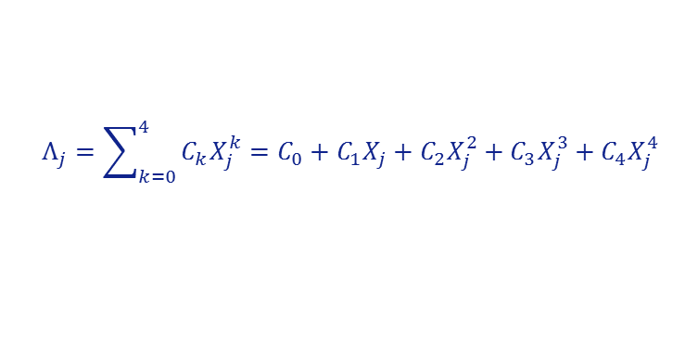
Fit algorithm
Perform a fit on the wavelength vs peak position and yield coefficients C_{k}
$$Λ_{j}=\sum_{k=0}^{4}{C_{k}X_{j}^{k}}=C_{0}+C_{1}X_{j}+C_{2}X_{j}^{2}+C_{3}X_{j}^{3}+C_{4}X_{j}^{4}$$
$$X_{2},Λ_{2}$$
$$X_{1},Λ_{1}$$
The blue curve shows the resulting 4th order polynomial fit

Slide 38
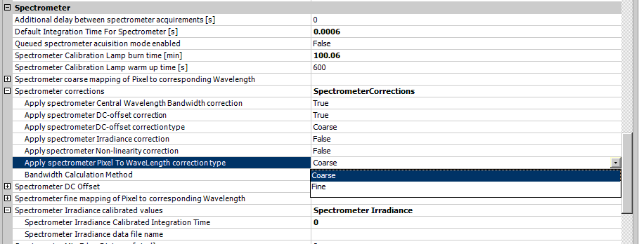
How to perform task #619
Equipment constant → Sensing → Spectrometer
Coarse: Task #600
Fine: Task #619

Slide 39
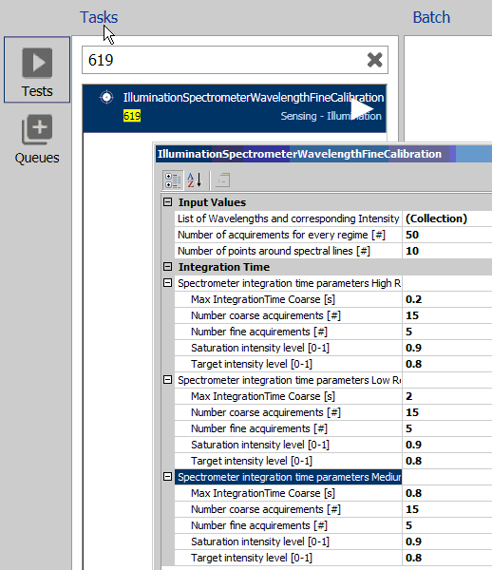
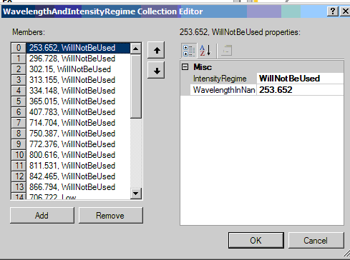
How to perform task #619
2. Check the task inputs
3. Run task #619 and commit ECs.
Spectral lines for calibration source
High intensity regime
Low intensity regime
Medium intensity regime

Slide 40
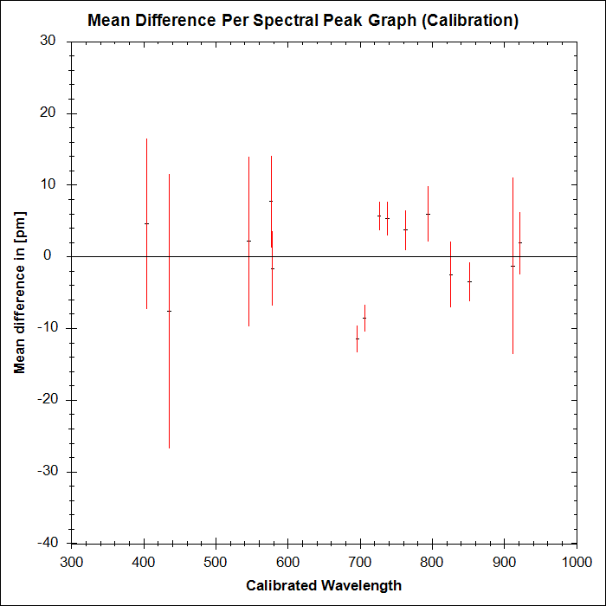


How to verify task #619
Task #626 Check Illumination Spectrometer Wavelength Fine
$$Δ_{j}=\frac{1}{N_{p}}\sum_{i=1}^{N_{p}}{λ_{i,j}−Λ_{j}} ∀ j \text{where} Y_{j}>0$$
where $λ_{i,j}$ is the $i$^{th} measurement of spectral peak $j$.
Spec:
<50pm
<50pm

Slide 41
Problem | Cause | Solution
Acquire software controller throws an error: The expected camera is (are) not found | Spectrometer not connected, or power not connected. | Ensure spectrometer is properly connected and power is delivered.
Acquire software controller throws an error: Frame capture timeout error | Spectrometer connection lost during Operation. | Ensure power and data cables are connected properly & securely.
The number of performance spectra is set to a number < 10. | To avoid influence of shot noise on the performance, this number must be ≥ 10. | Set N_{p} to 50 (the default value).
During calibration, the spectral peak is on the edge of the detection area. | The calibration lamp is not connected or power is not connected. The temperature of the CL module is incorrect. | Ensure that the calibration lamp is connected properly and power is delivered. Check that the temperature setpoint is correct (typically 35°C). If not, set it to the correct value and wait until the setpoint is reached. Then repeat the calibration.

Slide 42
#628 Illumination Spectrometer Performance

Slide 43

#628 – Check Illumination Spectrometer
Goal Task: To check if the internal spectrometer is working correctly
Reason for introduction: To be able to check spectrometer performance
Task Dependencies: 619
Factors affecting the reliability of the spectrometers:
Temperature of the spectrometer optics
The presence of camera or pixel with deviating behavior
The pixel to wavelength calibration (task 619)
Notes:
- Checks the spectrometers SNR, pixel intensities, temperature

Slide 44
Overview
Specifications have not finalized!
Cameral/Pixel performance check:
Disabled pixels
Hot pixels
Dark Noise
Dark Signal Spread
Photo Response Non-Uniformity (PRNU)
Signal to Noise
Pixel to Wavelength Check (Check task #619)
Notes:
The wavelength step between two neighbor pixels is about 0.32 nm. Each pixel is 14 um width and 200um long, so that the physical distance between two pixels is 14 um.

Slide 45

Hot pixels
Spec: Max signal < Average +10*standard deviation
Hot pixels are individual pixels which look much brighter than they should. They are also called sparkles.

Slide 46


Dark Noise
Spec: Average Standard Deviation Dark Noise<18
Maximum Dark noise deviation<44
IT=30us
Dark noise is statistical variation in the number of electrons thermally generated within the pixel in a photon-independent fashion, and is the electron equivalent of photon shot noise.

Slide 47


Dark Signal Spread
Spec: 0<counts<1000 for each 3 integration time, 30us, 0.25ms, 2.5ms
Notes:
Same as the Dark noise, but this time check 3 different IT.

Slide 48


Photo Response Non-Uniformity (PRNU)
Spec: Pixel Signal Factor=4±0.2 for each pixel
This is about uniformity of the photo response of the pixels wrt each other.
Signal_Factor = Signal(IT_1)_{pixel(n)} / Signal(IT_2)_{pixel(n)}
(The IT_2 is ¼ times of the IT_1 time)
IT_1=2.5ms
Notes:
Signal_Factor = Signal(IT_1)_{pixel(n)} / Signal(IT_2)_{pixel(n)}
default 1/(1/4)±5%= 4±5%
The IT_2 is ¼ times of the IT_1 time

Slide 49


Signal to Noise Ratio
Spec: SNR>200, Average SNR for Each Pixel >250
Per pixel SNR(n)= Average(signal_{(pixel(n)}) / st-dev_{(pixel(n)}
SNR(camera): Average{(Average(signal_{pixel(n)})/St-dev_{(pixel(n)}} for n=1-2048)
Notes:
This is OoS.

Slide 50






Pixel to Wavelength Calibration Check
Last measurement
Spec: Max diff betw. the Performed and the EC value< 0.05 nm
Max diff betw. the Performed and the supplier’s< 1 nm
<1 nm
Existing EC
<0.05 nm
Supplier

Slide 51
Problem | Cause | Solution
Spectrometer camera OOS | # hot pixels > 0 PRNU OOS Dark Noise OOS SNR(Camera) OOS Dark Signal Spread OOS | Swap spectrometer
Temperature of spectrometer <35°C | -Heater not connected to controller (external spectrometer has stand-alone controller). -PLC not initialized -Heater broken | -Connect spectrometer to controller -Initialize PLC -Swap spectrometer
Delta between current and last spectrometer calibration too large | -Temperature spectrometer <35°C -No specific reason than last calibration is a long time ago | -Make sure the temperature becomes 35°C again (see above) -Perform the ‘Illumination spectrometerwavelength calibration and commit EC’s
Delta between current and supplier spectrometer calibration too large. | -Temperature spectrometer <35°C -No specific reason | -Make sure the temperature becomes 35°C again (see above) -If temperature OK, calibrate P2W and SWAP spectrometer at first opportunity
Calibration source usage hours exceed lifetime | usage | -If no problems with wavelength calibration task: proceed as is, order calibration source for future swap.
Calibration source maximum signal lower than expected at integration time of 300 ms. | -Calibration source fiber damaged (4022.656.13632 YS SE CL CALIBRATION FIBER) -Calibration life time exceeded. Calibration source dysfunction within life time (1500 h) | -SWAP fiber and check results again. -Swap calibration source and check results again

Slide 52
Thank you
Q&A

Slide 53

Feedback from key sensors
Camera Integration Times
Significant difference between H/V

Slide 54


Slide 55
Task diagnostics
We have several tasks that can give valuable feedback when run with diagnostics ON.
Such as:
Task 602 (Pixel to WL Calibration)

Slide 56

Task diagnostics
Change the “WL_BW_Entries.debugim” file name to “WL_BW_Entries.png”

Slide 57

Task diagnostics
An Example: task 602
Image of task 602 after diagnostics turned ON.
Notes:
Task 602 - Calibrate Illumination Encoder Position To Wavelength
Supposed to see all wavelengths but we have a missing part somewhere below 425 nm.
Indication of low intensity incoming to CL Module (spectrometer)

Slide 58
Dashboard Tasks
An Example: task 609
Some dashboard tasks have their answer and they can be easily found.
Such as:
Task 609 (CL dashboard)
Notes:
Task 602 - Calibrate Illumination Encoder Position To Wavelength
Supposed to see all wavelengths but we have a missing part somewhere below 425 nm.
Indication of low intensity incoming to CL Module (spectrometer)

Slide 59

Dashboard Tasks
An Example: task 609
Notes:
Double peak clearly visible with task 609

Slide 60
Case Studies
Low Intensity Issue
Task 625 (Pixel to WL Calibration Performance Task) throws an error about some WLs that are not possible to be produced.

Slide 61
Case Study - 1
Low Intensity Issue
Task 625 (Pixel to WL Calibration Performance Task) throws an error about some WLs that are not possible to be produced.
Run Task 602 with diagnostics ON

Slide 62
Case Study - 1
Low Intensity Issue

Slide 63

Case Study - 1
Low Intensity Issue
Cause
(found by troubleshooting)
Problem
Containment
Lamp On Detect Voltage
3V
Swap QCM
Check IT with task 609
Swap CLM
Notes:
Problem: Low light intensity. 2 identical situations, 2 different causes.
Lets find the root cause. Check the feedback points from the system.
First Lamp on Detect (3V, typically around 8V)
Read the laser power (400W)
Than it should be between the laser and light sensor (QCM)
2nd scenario: the lamp on detect voltage was 8V, normal so the problem should be after the light sensor, before Spectrometer (Fibers)
Since the integration times were too high, the suspicion was on fibers.

Slide 64
Case Study - 2
Double Peak Issue
Task 625 (Pixel to WL Calibration Performance Task) throws an error about some WLs that are not possible to be produced due to double peaks

Slide 65
Case Study - 2
Double Peak Issue
Task 625 (Pixel to WL Calibration Performance Task) throws an error about some WLs that are not possible to be produced due to double peaks
Run Task 602 with diagnostics ON

Slide 66

Case Study - 2
Double Peak Issue – Task 602 diagnostics image

Slide 67

Case Study - 2
Double Peak Issue – Task 609 view

Slide 68
Case Study - 2
Double Peak Issue
Characteristic of the Light Source: so containment was a SW algorithm change.

Slide 69
Thank you

Slide 70
To-do-list
600→need pictures→Done
604→Done
611→need to review contents→Done
612→need to review contents→Done
619 →need pictures Done
628 →need pictures/ Run 628 with P2W check True Done

Slide 71
Content of SW package – Q Tool
Spectrometer calibrations, inline offset correction & performance tasks
Internal Spectrometer
CL Module
External Spectrometer
Task 623
DC Offset
Task 604
DC offset
Task 600
WL coarse
Task 605
WL home offset
Task 613
WL coarse
Task 616
DC offset
Task 624
DC offset
Task 611
Non-linearity
Task 612
Irradiance
Task 602
Enc Pos to WL
Task 625
Enc Pos to WL
Task 617
Non-linearity
Task 618
Irradiance
Task 626
WL fine
Task 619
WL fine
Task 601
ND filter
Task 641
ND filter
Task 620
WL fine
Task 627
WL fine
Task 628
Spectrometer
Task 610
Spectral
Task 629
Spectrometer
Task 603
WL offset
Task 630 has 603 included
Task 630
CLM spectral
existing calibration
new calibration
performance task

Slide 72
Content of SW package – YS system
Internal Spectrometer
CL Module
Task 623
DC Offset
Task 604
DC offset
Task 600
WL coarse
Task 605
WL home offset
Task 611
Non-linearity
Task 612
Irradiance
Task 602
Enc Pos to WL
Task 625
Enc Pos to WL
Task 626
WL fine
Task 619
WL fine
Task 601
ND filter
Task 641
ND filter
Task 628
Spectrometer
Task 603
WL offset
Task 630 has 603 included
Task 630
CLM spectral
calibration task
performance task

Slide 73



Calibration source/ spectrometer temperature check
>40000
<1500
34<Spectrometer temperature<36

Slide 74



Slide 75
Requirement | Value | Remark
Spectral measurement
Wavelength range | 400-900 nm | Use case to measure ~10nm peaks that appear at random place within this wavelength range
Optical resolution | <=0.051 nm | Typically: FWHM width of an infinite narrow bandwidth (over the spectral range). In our case: how accurate can we find a peak
Sensor resolution | <0.5nm per px | Per usable pixel in output data (binned pixels count as one)
Temperature stability | <0.04 nm WL / °C
Linearity | <nm / pixel10% | Within dynamic range
Stray light | Not worse than 30db%
Grating efficiency variation across the range (400-900nm) | <1.5x | With minimum absolute efficiency larger than 30%
Integration time | <100ms at 0.05mW input light power | Desired integration time is 10ms
A/D resolution | >=16bit
System configuration
Size (HxWxD) | Smaller than 9100x9100x6100 mm
Weight | < 800 700ggr
Operating temperature | 20-440 °C | (wish till 50°C )Expected temperature in module
Average Ppower dissipation | <1W | EC&I
Interfaces and supplies
Optical interface Optical interface position | FiberBefore ND | Prevent integration time variation or S/N variation due to ND transmission differences
E-Interface type | Ethernet 100/1000mbps RJ45 | If not available, USB is the preferred alternative (for troubleshooting). with Cconversion to Ethernet is then needed (long distance interface from YS to subfab)..
E-interface data speed | ~100FPS @10ms integration timeData transfer rate > frame capture rate > 10x max frame rate of camera | Alternatively (if too ambitious) > 100 FPS @ nominal integration time
E-interface trigger | 24V PLC I/O | External trigger via PLC to synchronize acquirements. Trigger mode “pulse width” or fixed integration time. Possible trigger overlap ➔
SW-interface type | API | Use SW libraries (APIs) to build own application → no license should be needed
Voltage supply | 24V 0.5A max

Slide 76
Other requirements
Requirement | Value | Remark
Thermal stabilization | yes | Preferred built-in thermal stabilization (Peltier cooler for example)
Electronic shutter | yes
Memory for frame buffering | >100frames
EMC robust design (control of electro-magnetic interference) | GID722 | Alternatively IEC61000/EN55011 can be used. Can be solved with e.g. metal housing.
Lifetime spectrometer | <0.005 hits a year | Better than 0.005 failed items per year
Firmware updates | n.a. | Functionality must be robust for potential future updates of spectrometer firmware
Diagnostics | At least OK/NOK signal | Telemetry from spectrometer

Slide 77

The DC offset origin
The dark current offset has DC and AC components:
DC
Electronic offset such as programmed DC offset
Integrated dark photodiode current.
AC
Dark current shot noise
Read-noise
Position
Integration time
Temperature
Dark current would increase as the temperature increases
Notes:
AC
Shot noise is associated with the random arrival of photons which obeys a square root behavior w.r.t the dark-current),
read-noise comes from the pixel electronics such as in-pixel amplifier and read-out chain.

Slide 78

CW def:
BW def: FWHM

Slide 79
ID | Status | Requirement | Verification method | Where used | Notes
D000475242- CL_Spectrometer – 010 | UCC | Spectrometer accuracy w.r.t. Hg-Ar calibration source after calibration is <=0.05nm (see 5.7Appendix B ) | T(D) | Chapter 5.1 Confirmed by D000531467 | 15 main Hg-Ar atomic transitions lines cover the whole spectrum range that allows calibration full range of spectrometer with one source
D000475242- CL_Spectrometer – 020 | UCC | Spectrometer precision after calibration is <=0.05nm | T(D) | Chapter 5.1 Confirmed by D000531467 | Typical achieved performance is <=0.30nm
D000475242- CL_Spectrometer – 030 | UCC | Opto-mechanical drift within spectrometer assy must be <=0.005nm/K [in terms of CWL impact] | T(D) | D000536115 | Verified by experiments
D000475242- CL_Spectrometer – 040 | UCC | Spectrometer must be able to measure spectrum at least in the full range of 400-900nm | R |  | Current spectrometer covers from 390 till 910nm (see machine data)
D000475242- CL_Spectrometer – 050 | UCC | Spectrometer HW must be able to measure spectrum within required accuracy and precision with integration time <=2.5ms | T(D) | D000475242-CL_SW-070 | Spectrometer acquire is then always in the shadow of camera acquisition

Slide 80


CLM Spectrometer Calibrations
EPROM data for spectrum correction
LPPS
Cal. source
Avantes spectrometer
EPROM data processor (calibration)
CLM (HW ECs)
Output report/output data/postprocessing input

Slide 81



